Slide 1

BRTS BUS PASS ONLINE REGISTRATION APP Guided by: MANISH PATEL(H.o.D)
Presented by:
-Vishnu Burkhawala [206120316032]
-Jash Pastagia [206120316046]
-Dharmik Patel [206120316054]

Slide 2
index
Abstract
Purpose
​Scope
Information
Functional requirement
Non-Functional requirement
Overview of system
Future scope
Software component
User interface
Conclusion

Slide 3
Abstract
“BRTS BUS PASS ONLINE REGISTRATION APP” is an Android application, in which Customer can interact with this application and request for creating a new Bus Pass.
Customer have to upload the documents which are required for Bus pass and after online verification user gets message to select a slot for verification of their identity to the BRTS office.

Slide 4
purpose
The main problem in an existing system is that to manage bunch of paper works. User have to fill up the form for requesting a bus pass and verifier have to collect both form and required documents with user’s photos and signature, which are stored in specific place for further process. But it will be burdensome when any employees needs to fetch the data.
That user(travellers) needs to stand in a long queue for submitting a form and verification of documents.
User need to visit the BRTS office persistently to know how much process done.
User documents will not be safe.

Slide 5
Scope
The main aim of our application is to make the bus pass process fully digital and easy to implement.
User has to upload the required document online in the application.
Admin will check this documents uploaded by user and approve them as per the government rules from web portal.
After the approval the user can select the meeting time slot as per user’s preference for user identity verification.
After the successful identity verification of the user ,user becomes eligible to get the requested bus pass.

Slide 6
Information
In this system there is both application and web portal.
The application is for user, in which user(traveller) can login and request for pass and upload documents.
Web portal is use by verifier officer and the Admin, Admin is verify the document which are uploaded by user and verifier officer is verify identity of user .
Application and web portal are connected with a same database.

Slide 7
Function requirement
APPLICATION MODULE
Login Module
Sign up Module
Upload Document Module
Slot Booking
Status Of Bus Pass
Contact Us
My Profile

Slide 8
Function requirement
Web Portal
Web Portal is a web application which have following modules
Selection Module(To choose admin or verifier officer)
Admin’s view
Login Module
Document Verification Module
All user Data
Doc Verification Pending User
Doc verified User.
Eligible for Bus pass
Not Eligible for Bus pass
Status Module
Verifier(to assign user name Password and Branch)

Slide 9
Function requirement
Web Portal
Verifier ’s view
Login Module
Identity Verification Module with date feature
filtering
Status Module

Slide 10

Overview of system

Slide 11
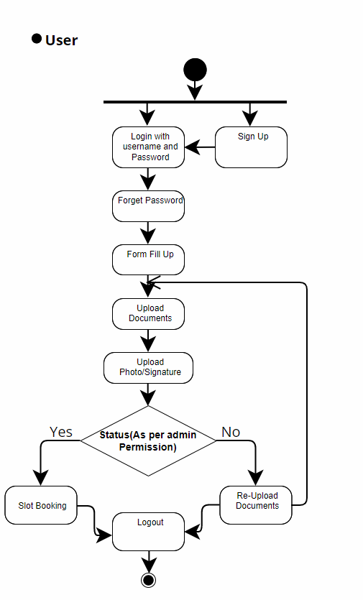
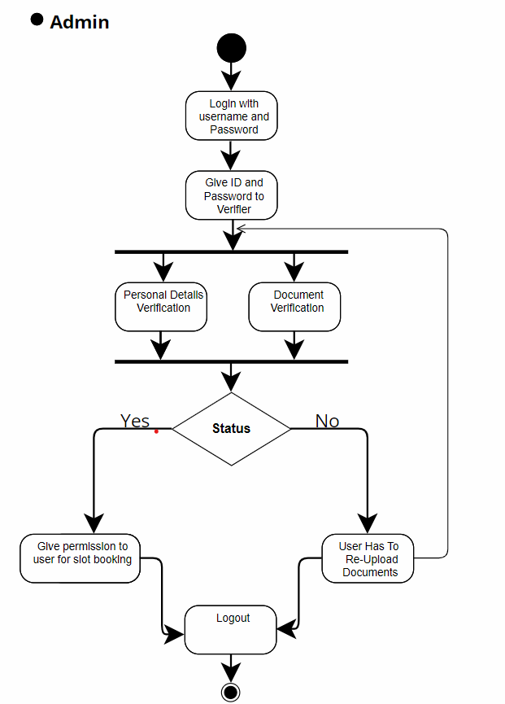
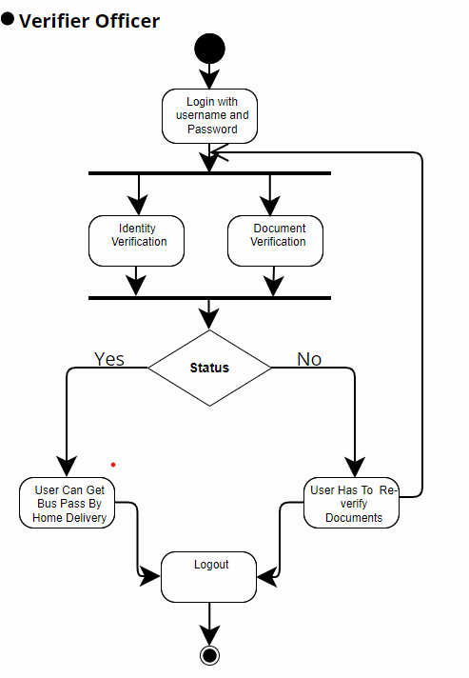

Slide 12

Software component

Slide 13
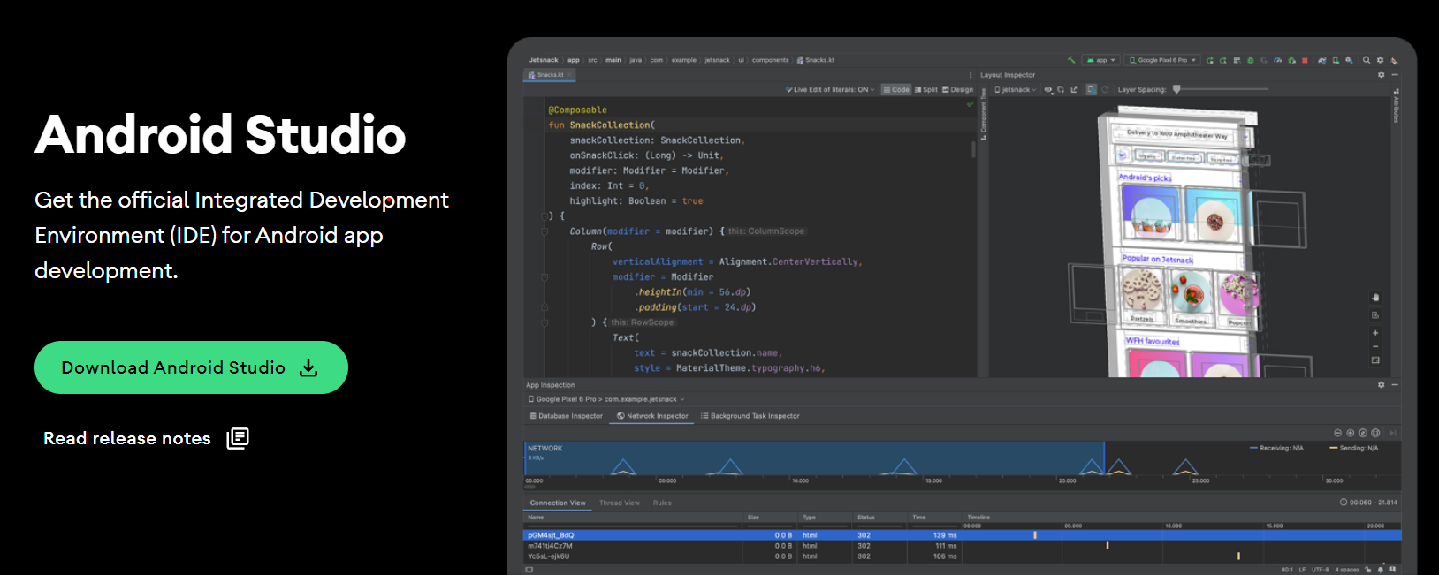




Application
Using the ANDROID STUDIO we will write the code of “BRTS BUS PASS ONLINE REGISTRATION APP” .
POSTMAN For Api.

Slide 14

Web portal
We will use visual studio code text editor to write a code of web portal.
It is not necessary to use visual studio code,
but we can use any text editor .
Web portal code is based on php(My Sql) and firebase.
We will use xampp server for storing data into database.

Slide 15

UI design of application

Slide 16
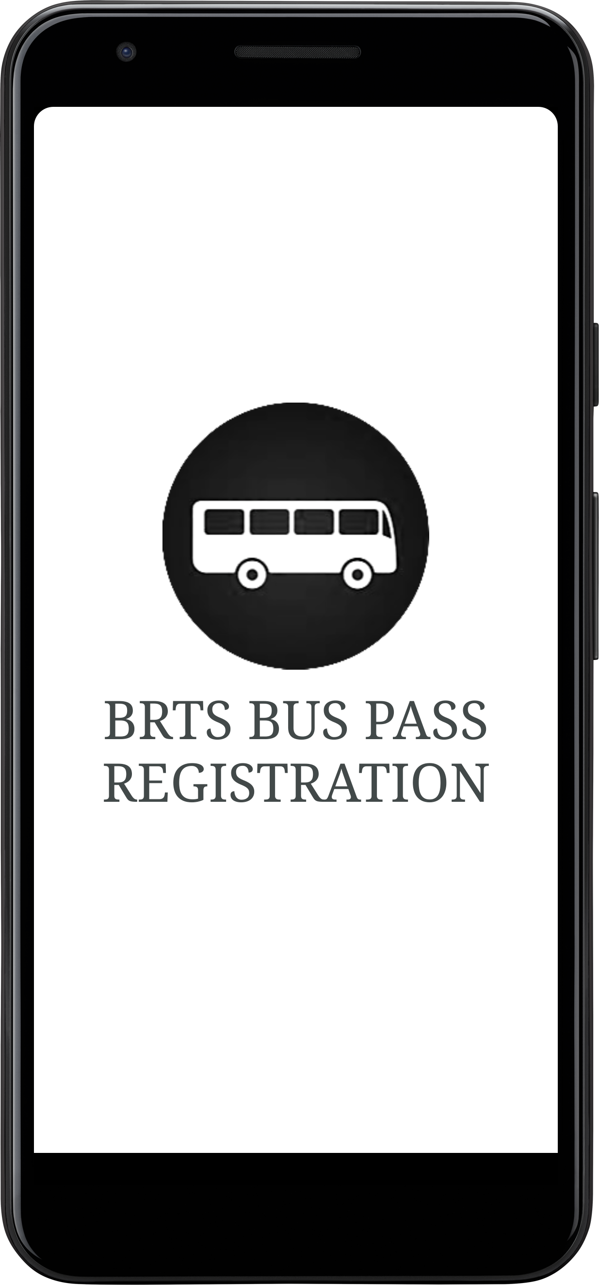

Starting Welcome Page

Slide 17
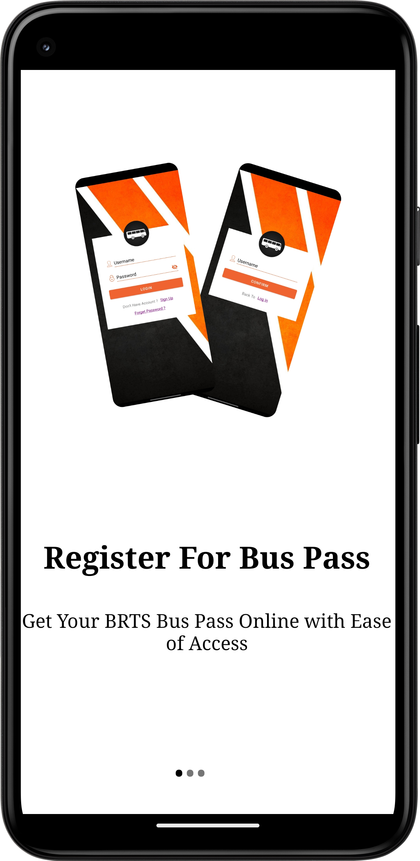
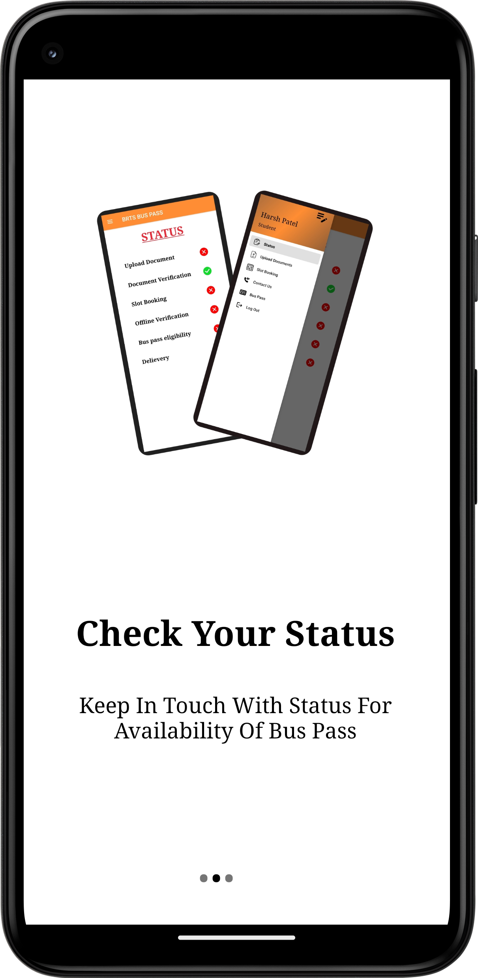
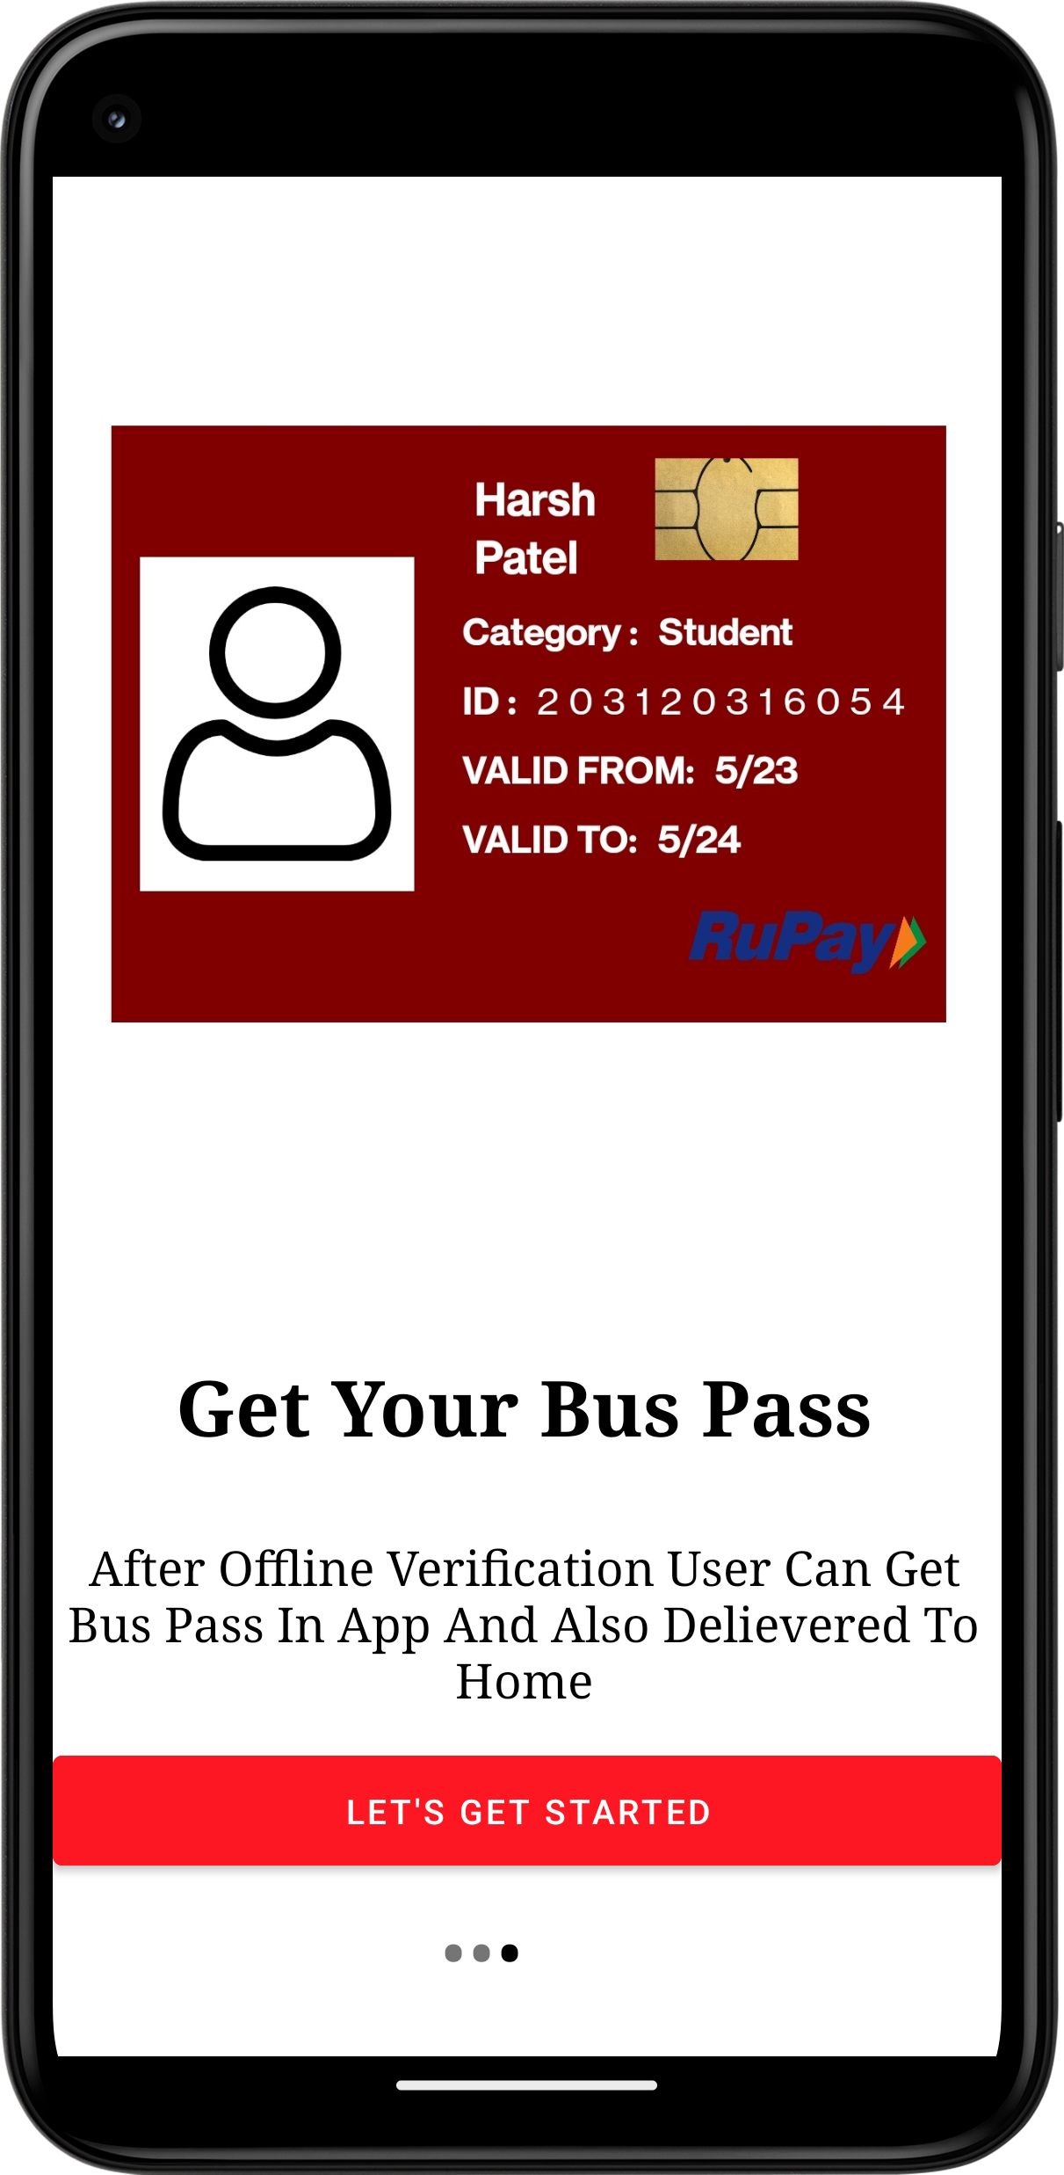
Walk Through
(User can get detail about app)

Slide 18
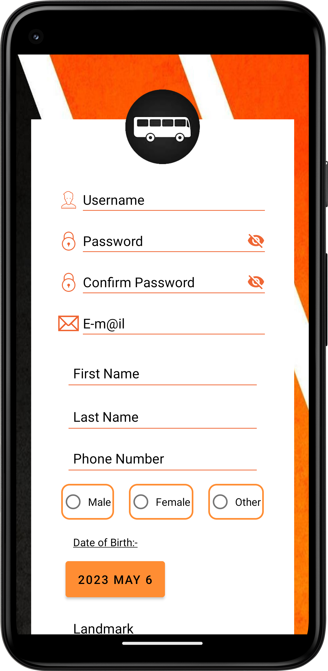
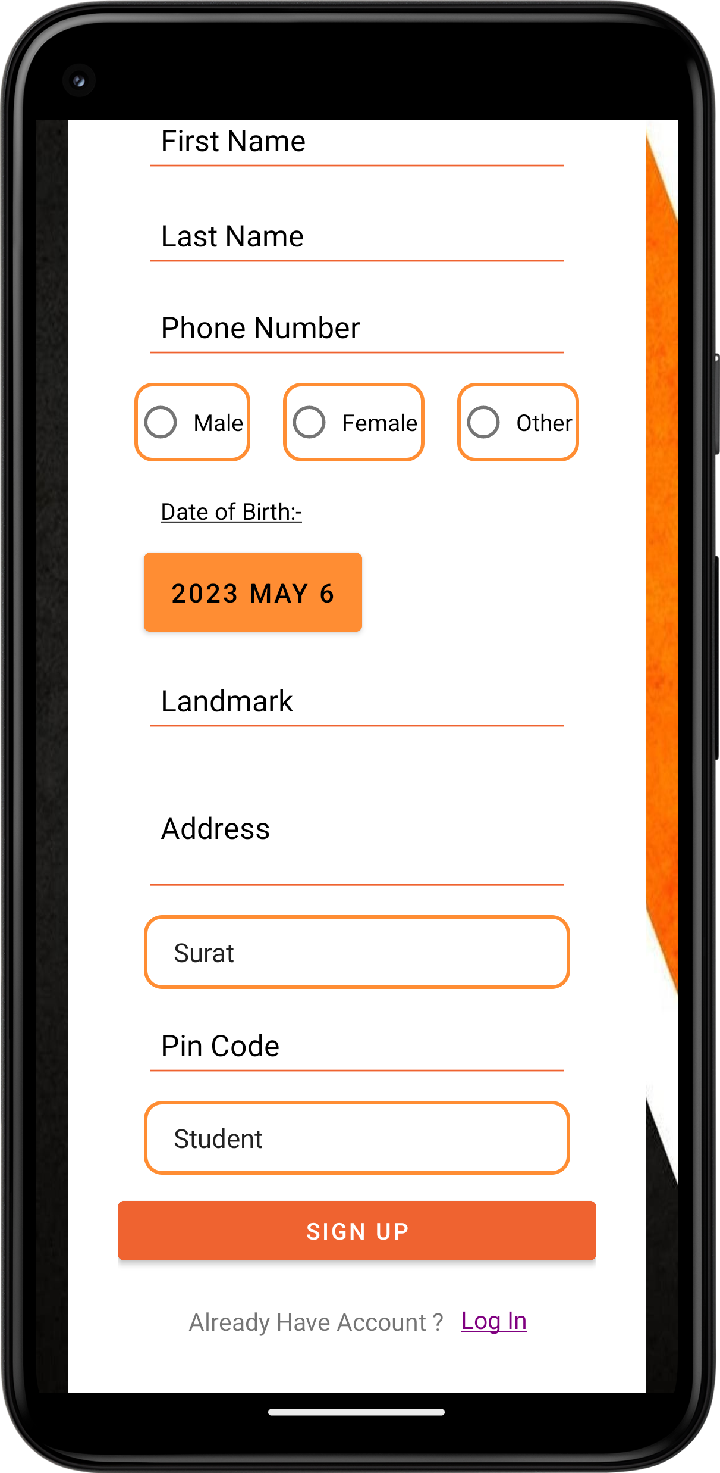
Signup page
(User can create new account)

Slide 19
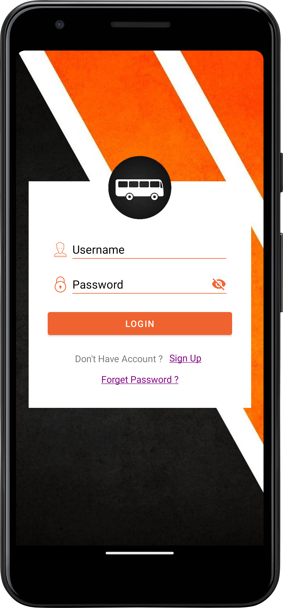
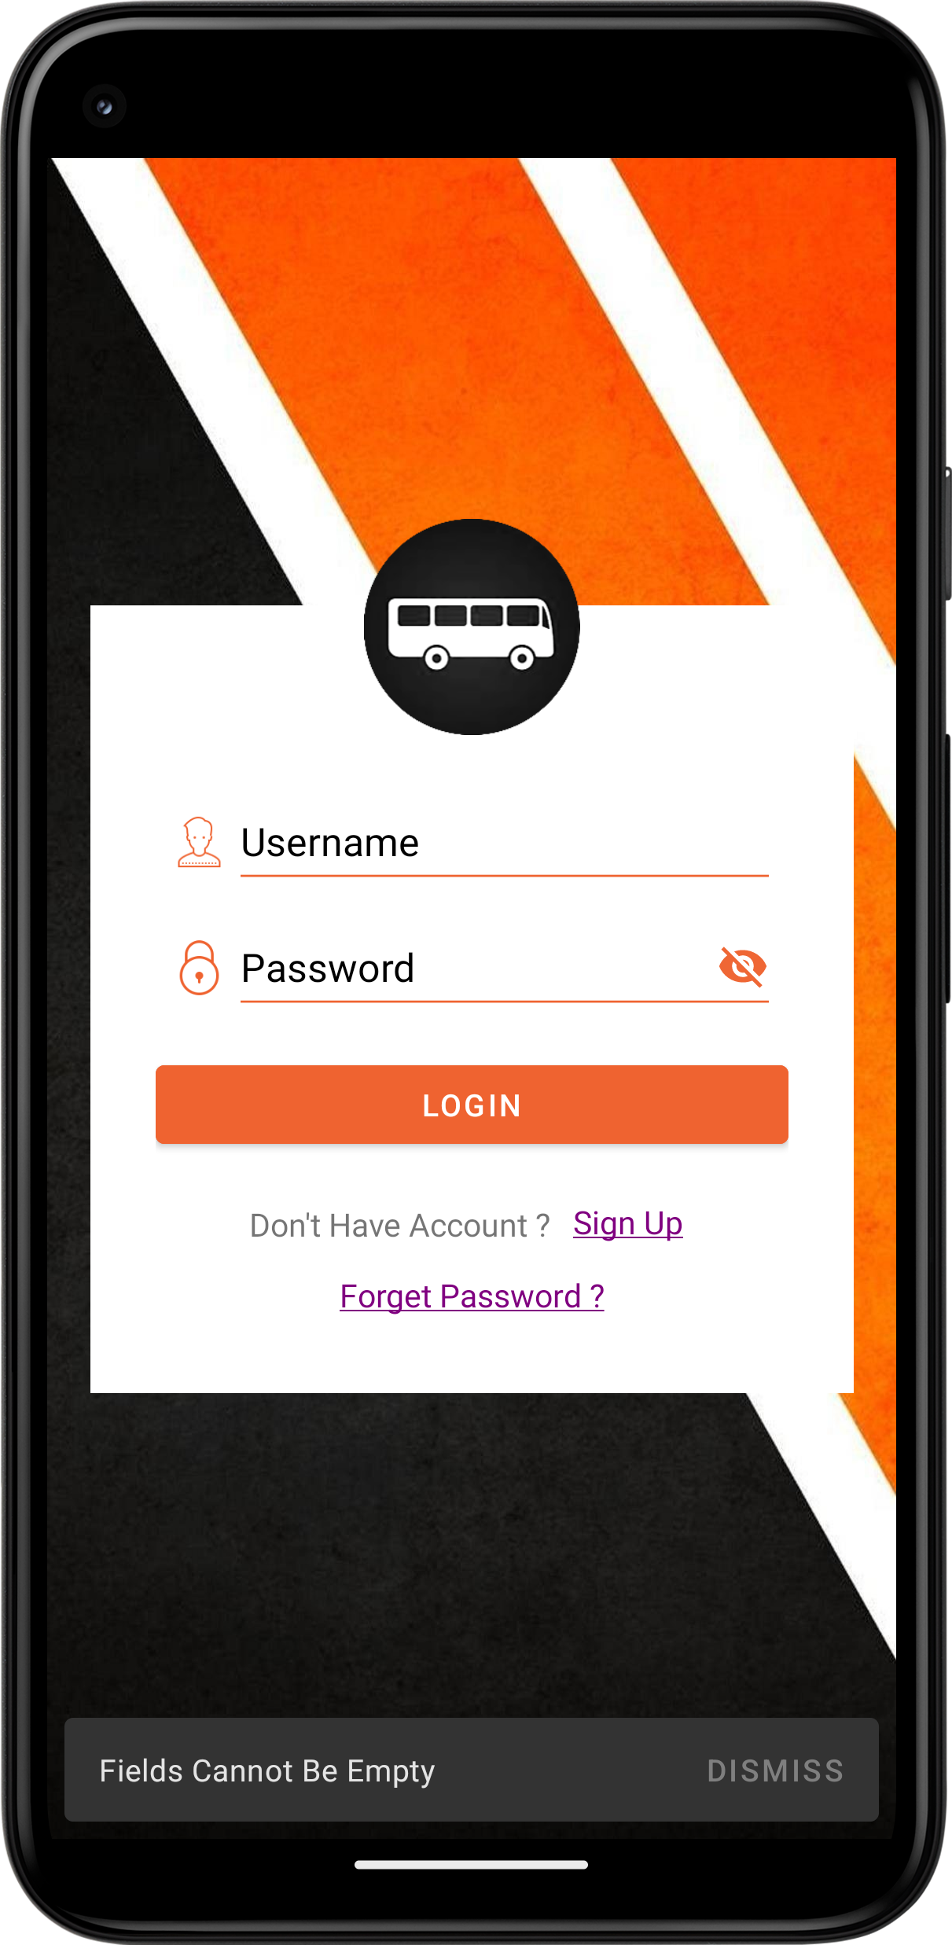
Login page
(user can login using their valid username and password)
Showing SnackBar on Empty Field Submit

Slide 20

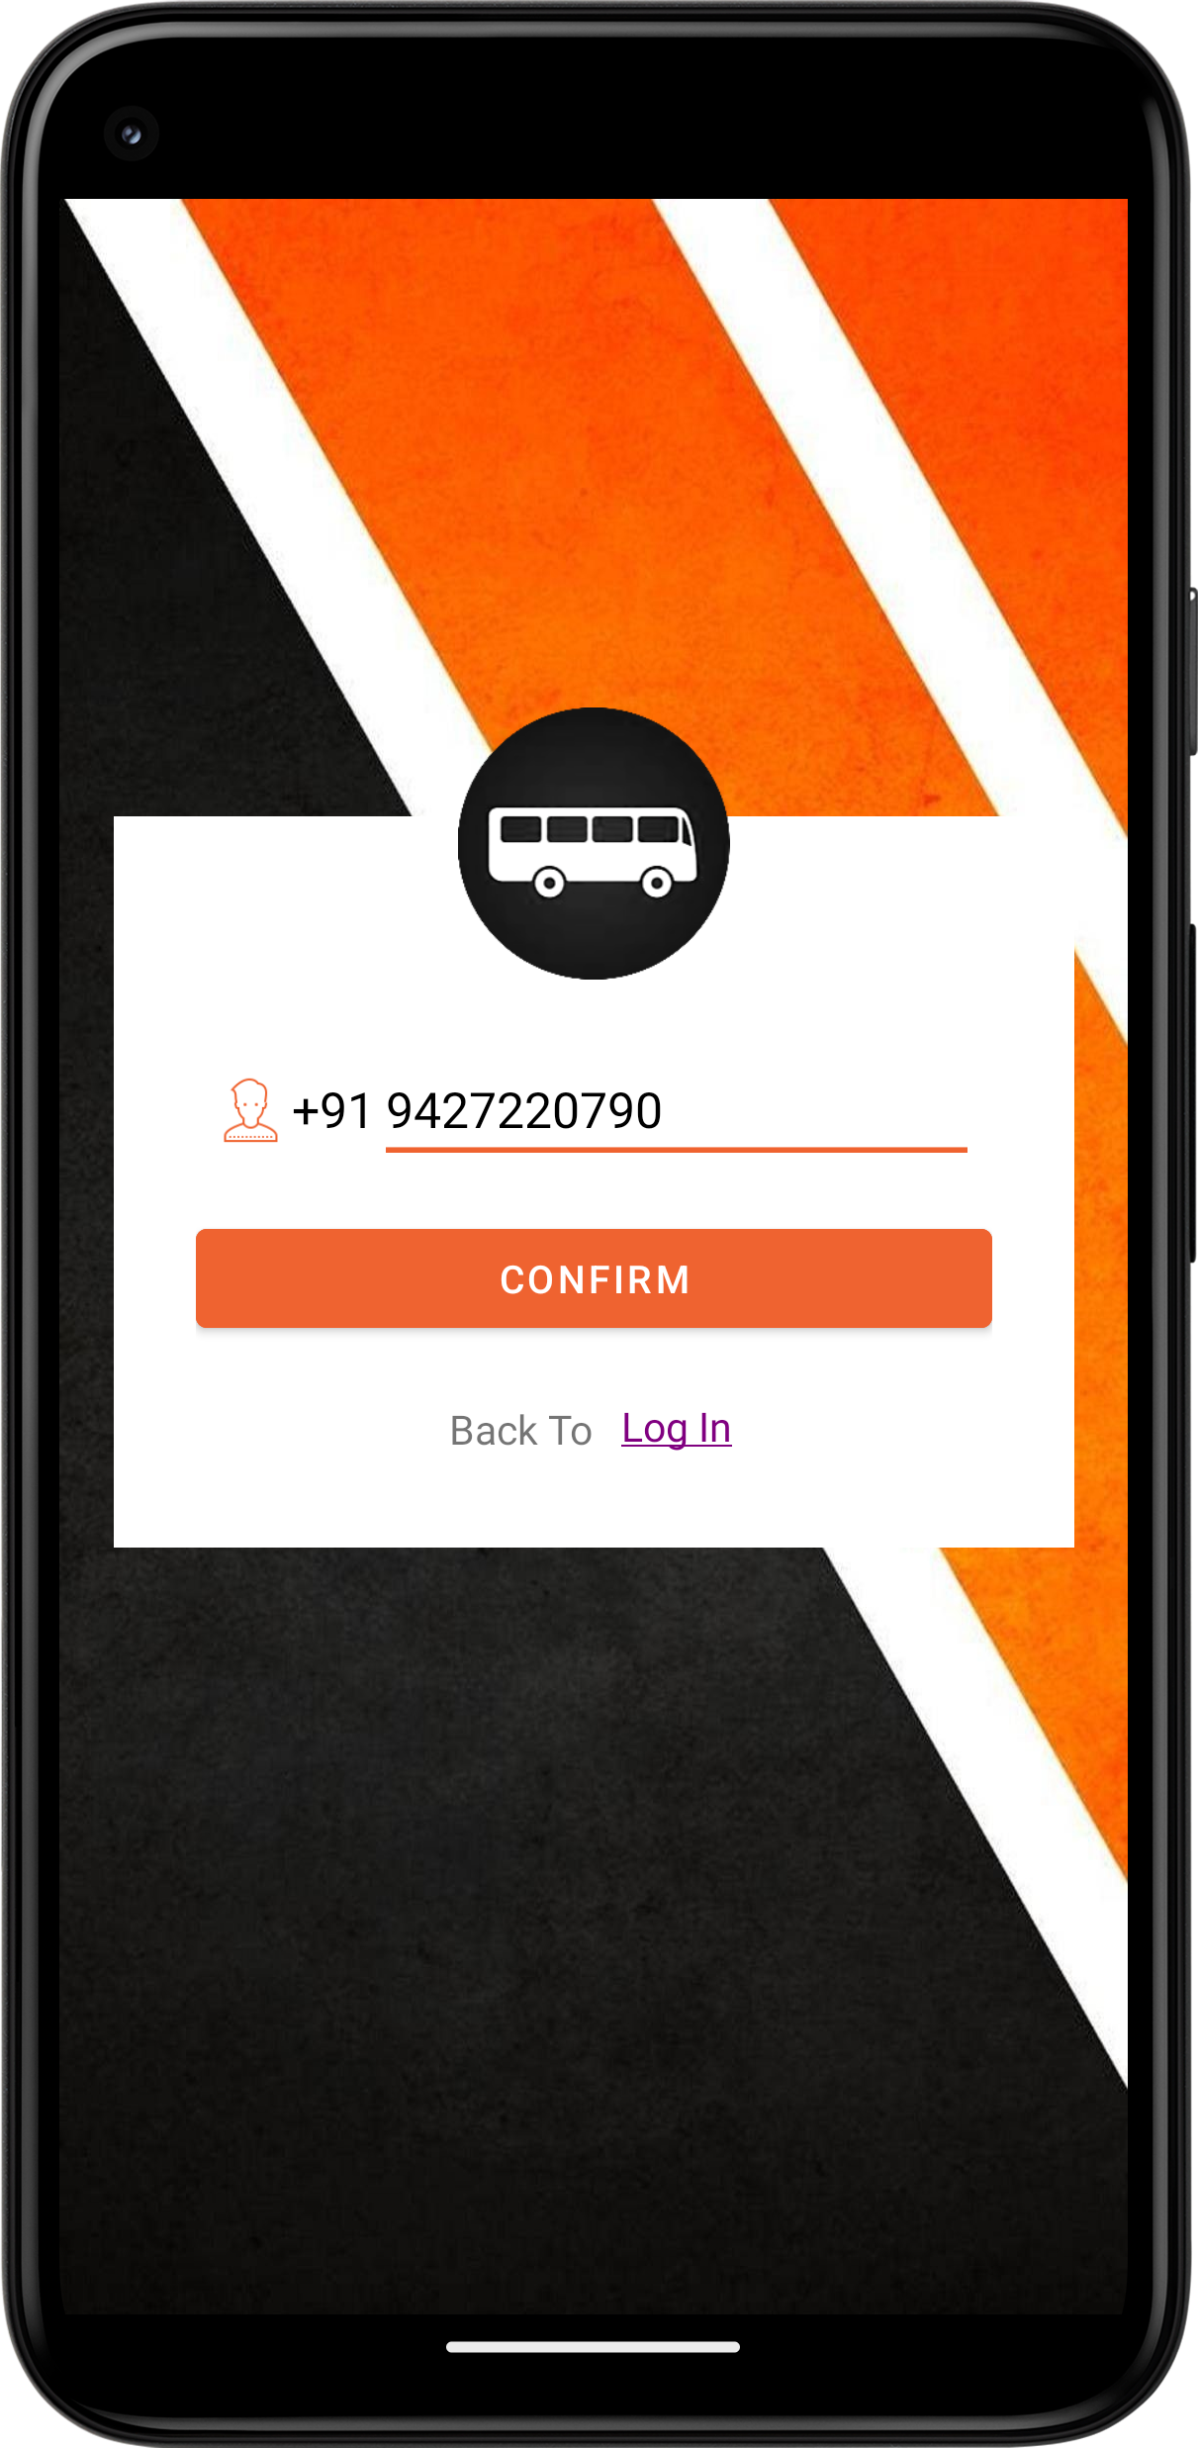
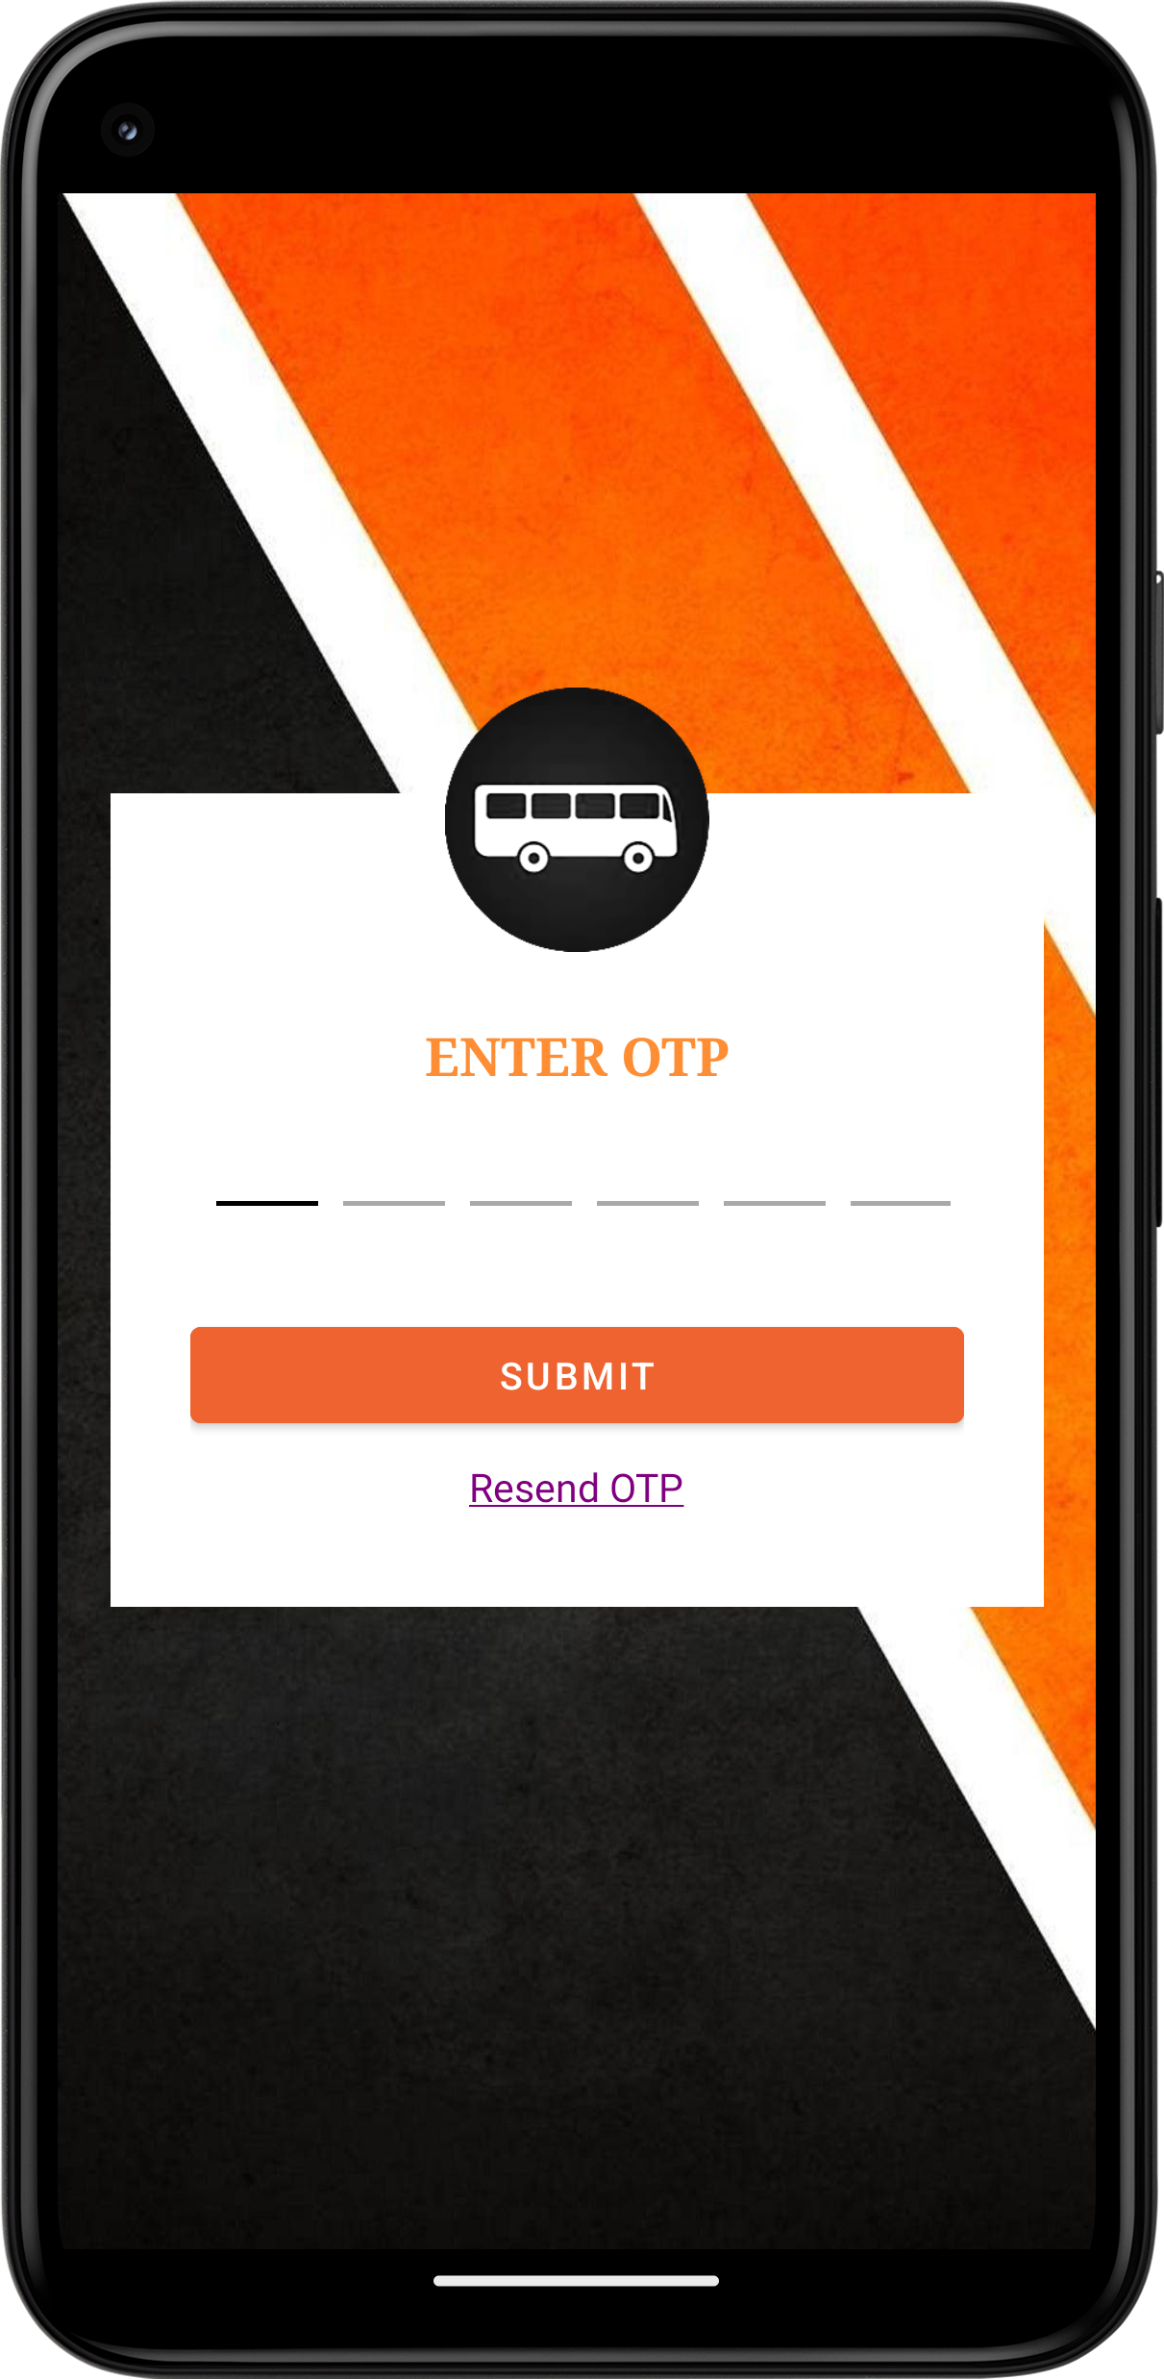


FORGOT PASSWORD
Password visible
&
Password invisible

Slide 21
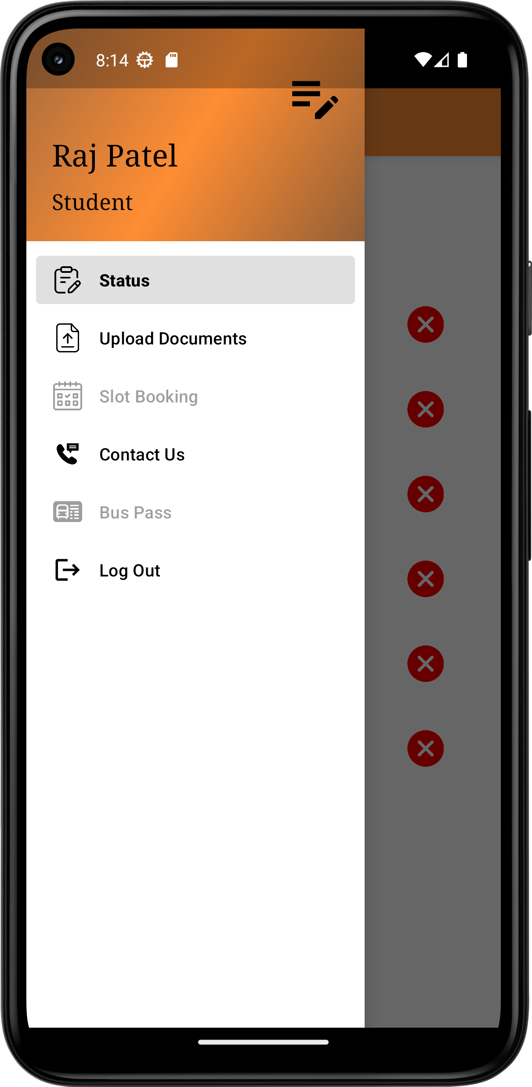
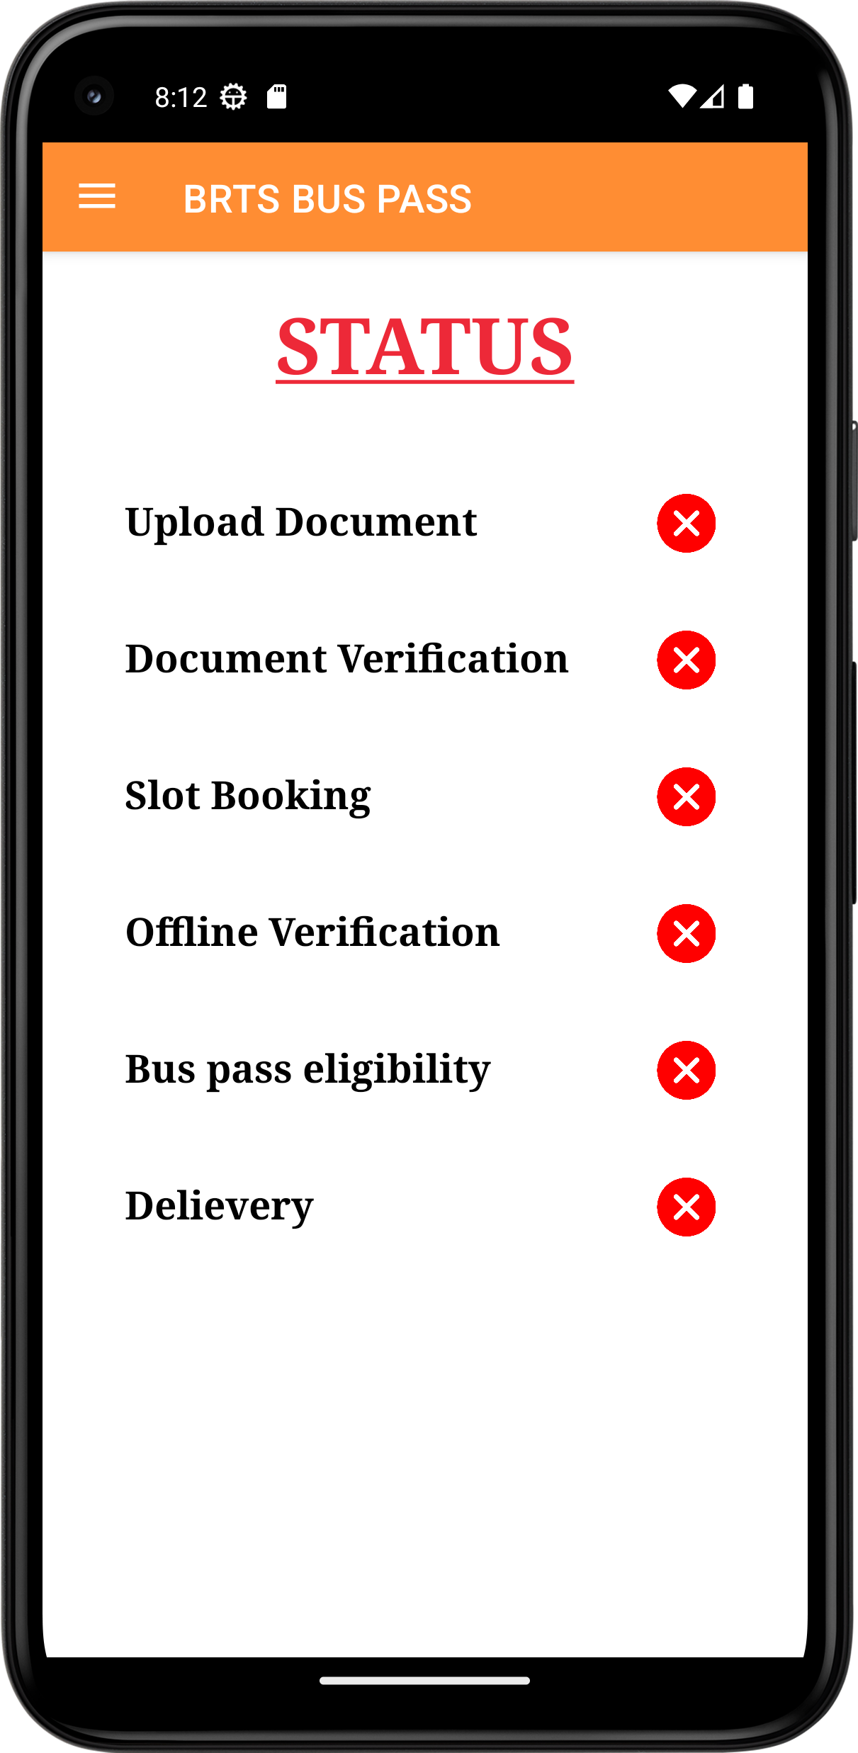
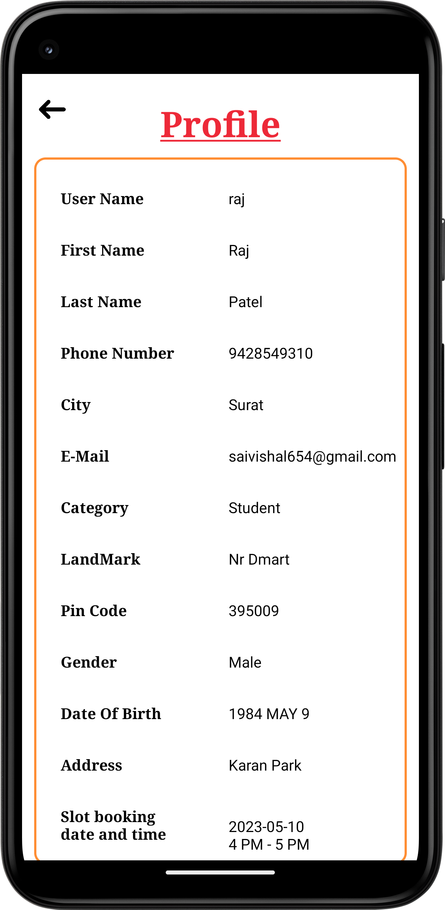
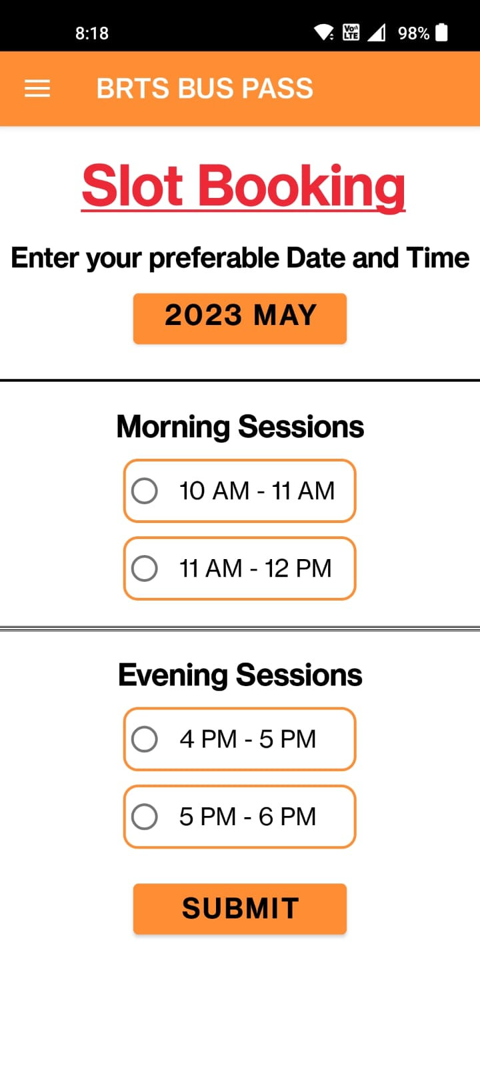
Side Navbar
Status Of User
Profile Of user
Sloot Booking

Slide 22
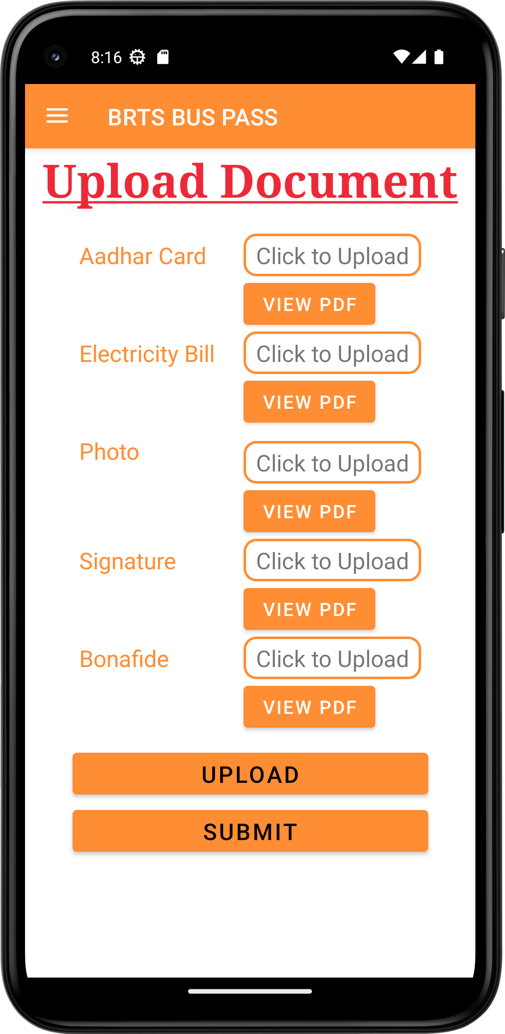
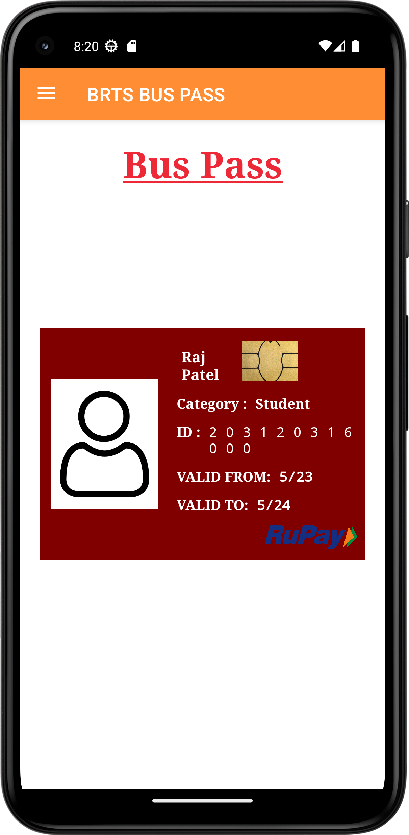
User Upload Their Documents
E-BUS PASS

Slide 23
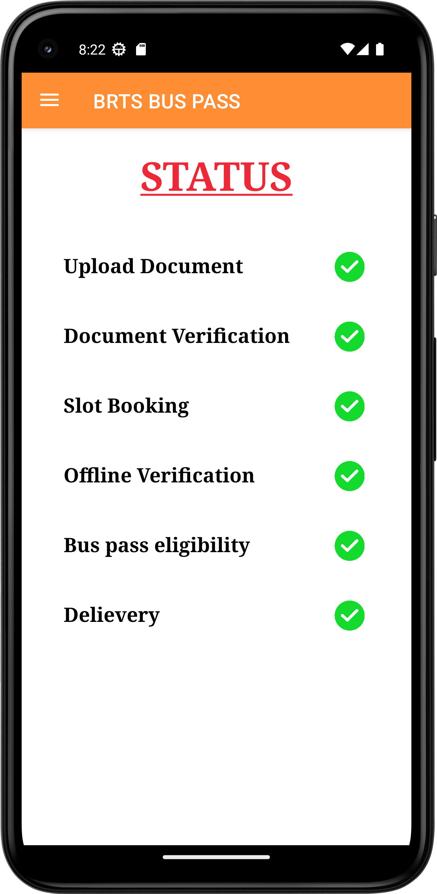
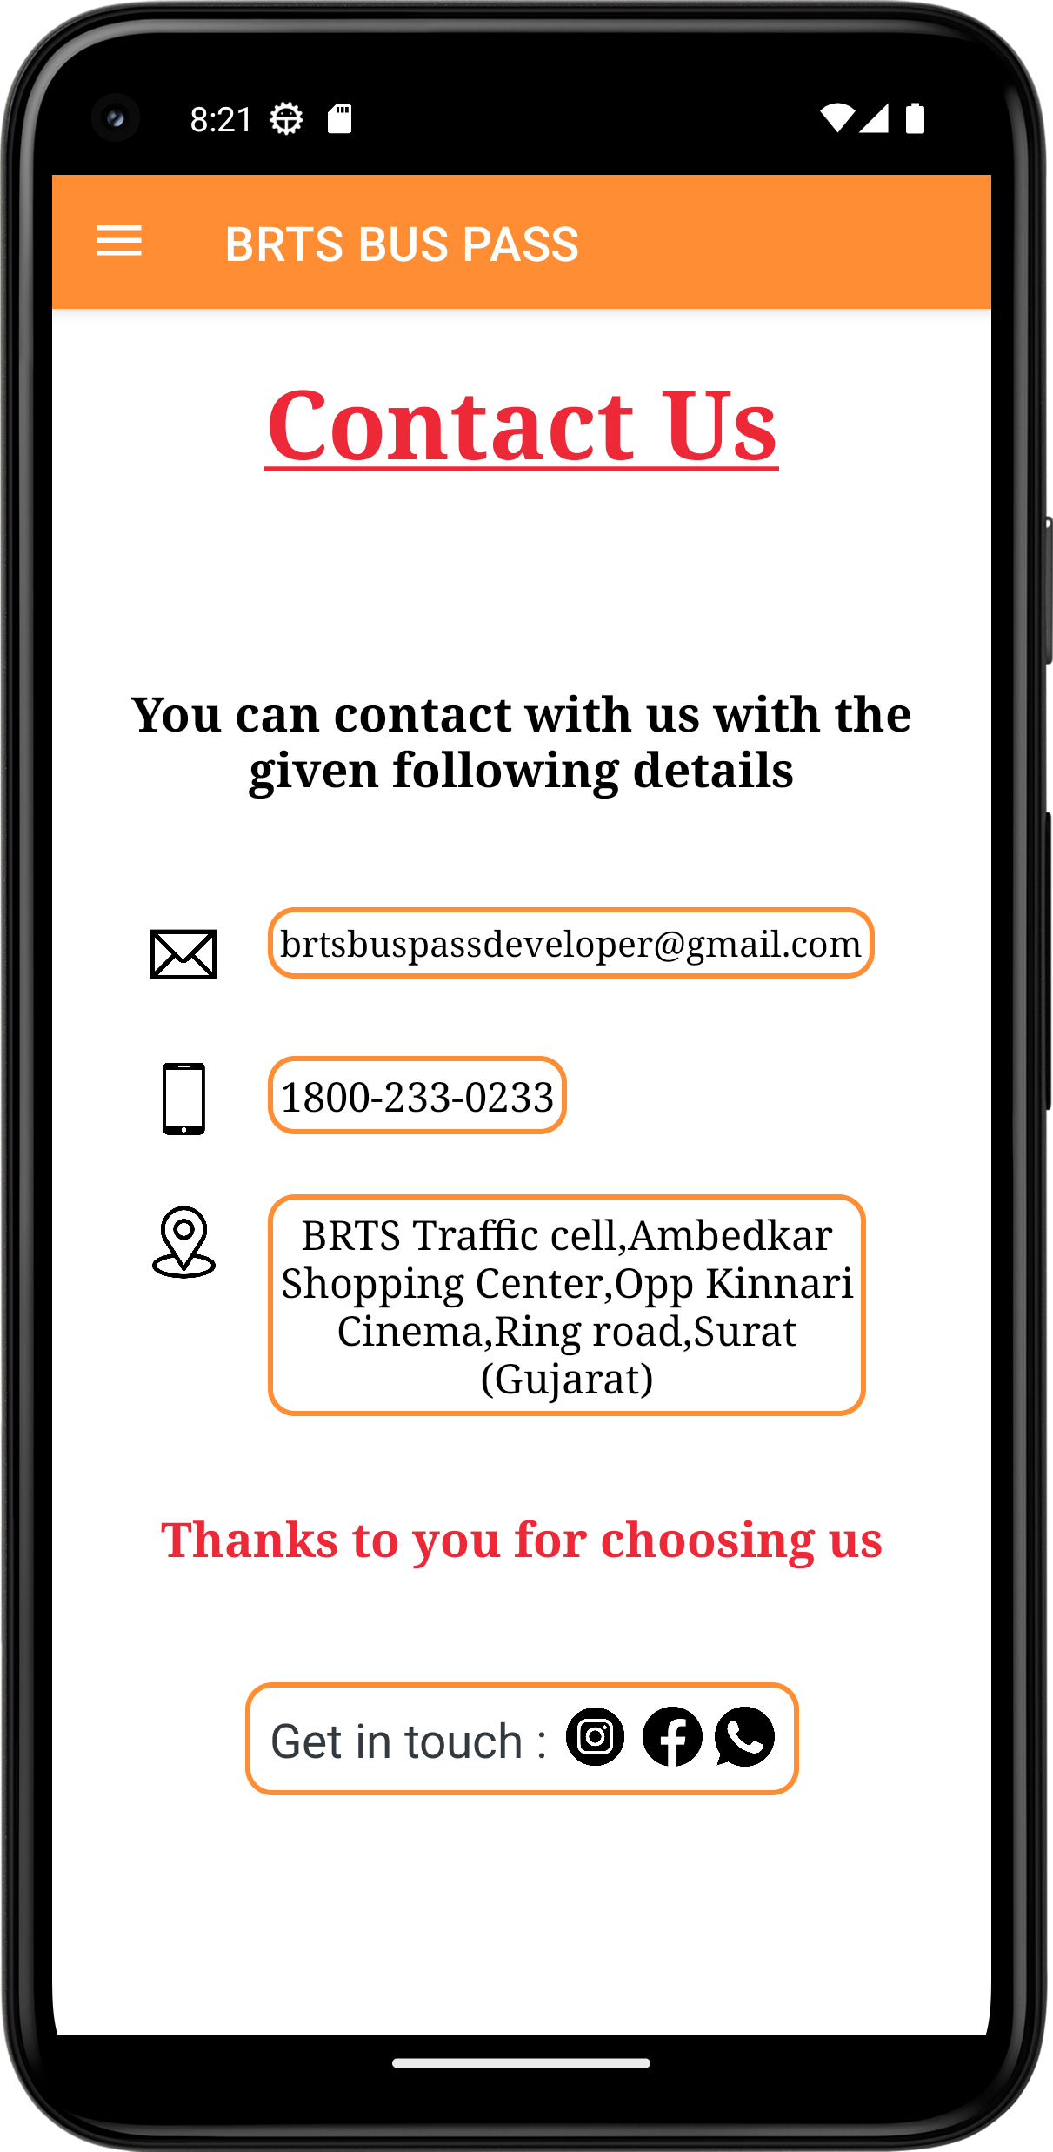
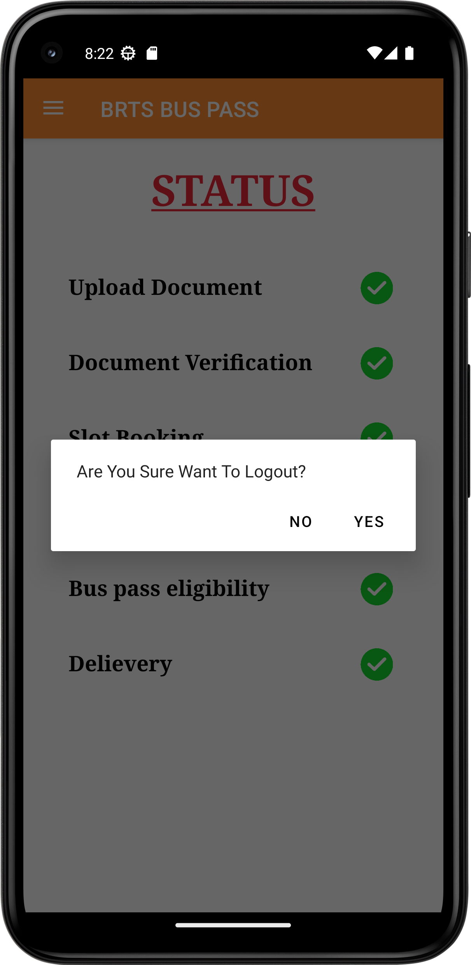

Status (when all done)
Contacts Us
On Logout

Slide 24
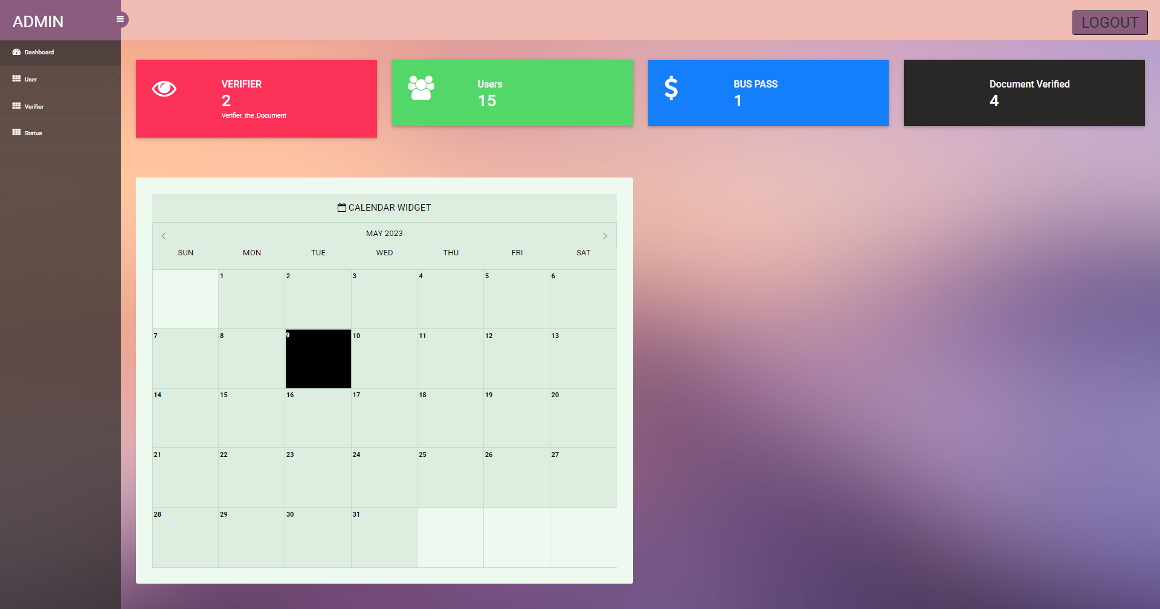
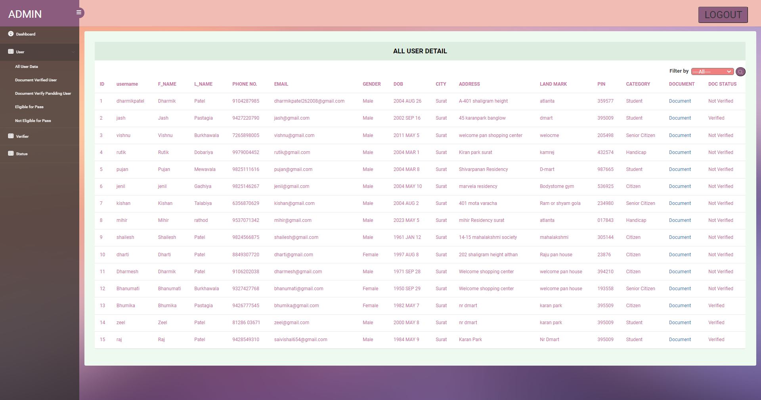
ADMIN DASHBOARD
All User Data

Slide 25
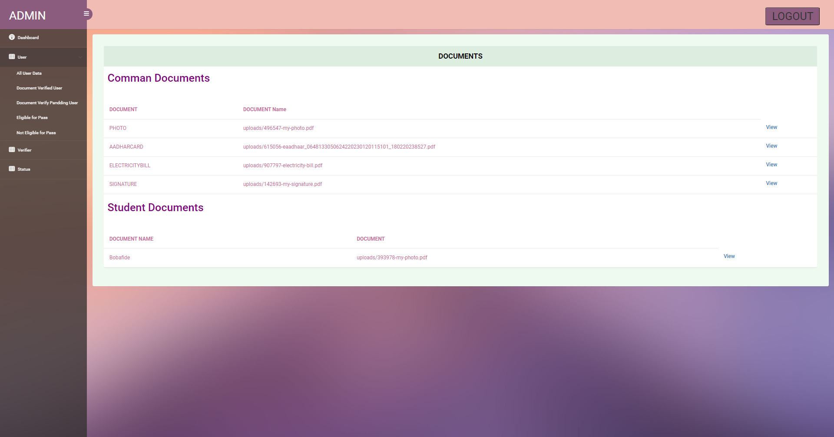
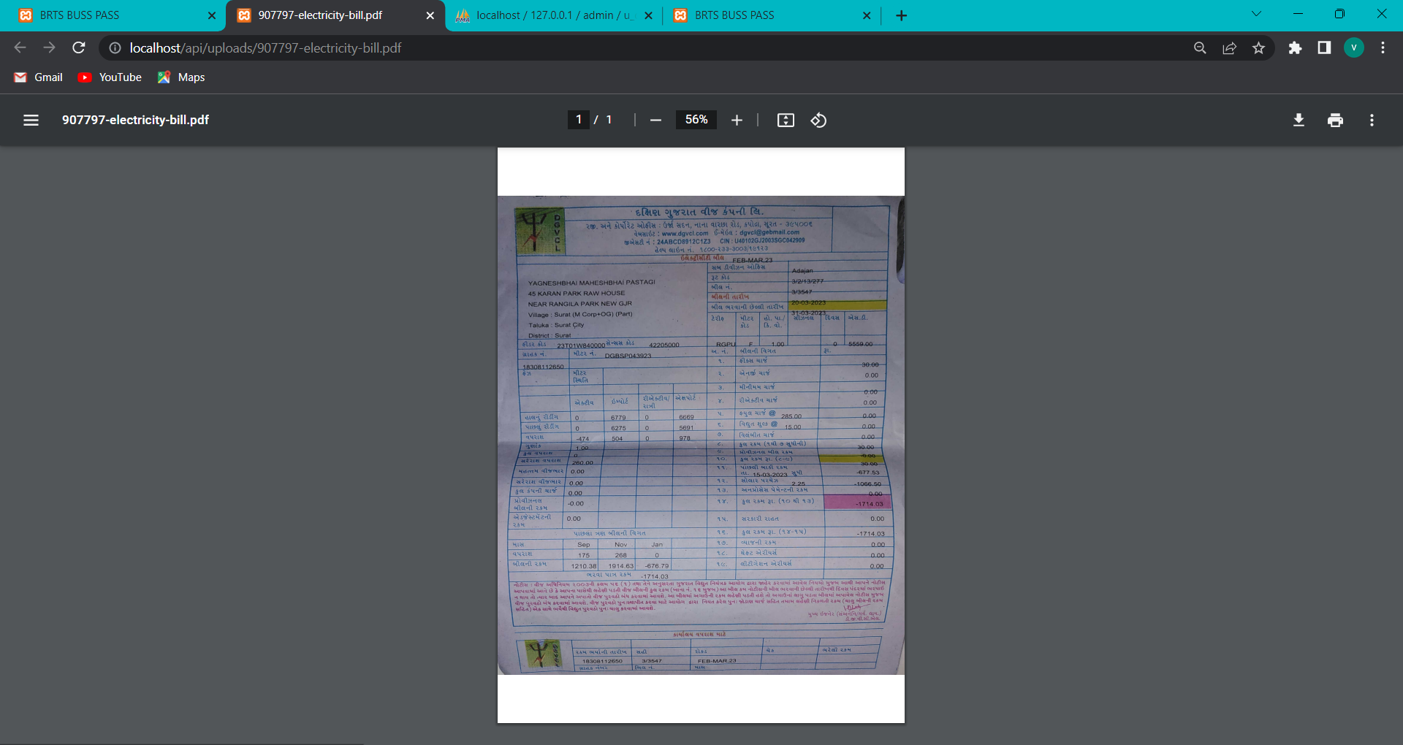
When Click on Document Of Particular User
On Click View

Slide 26
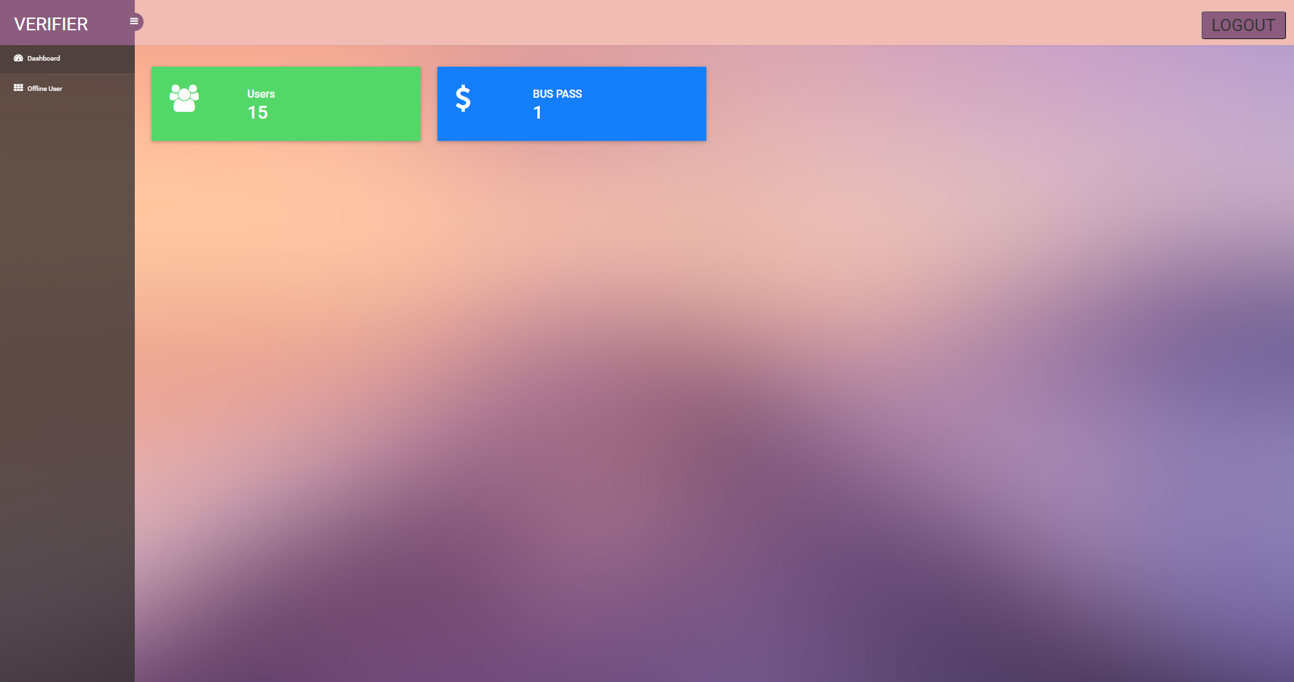
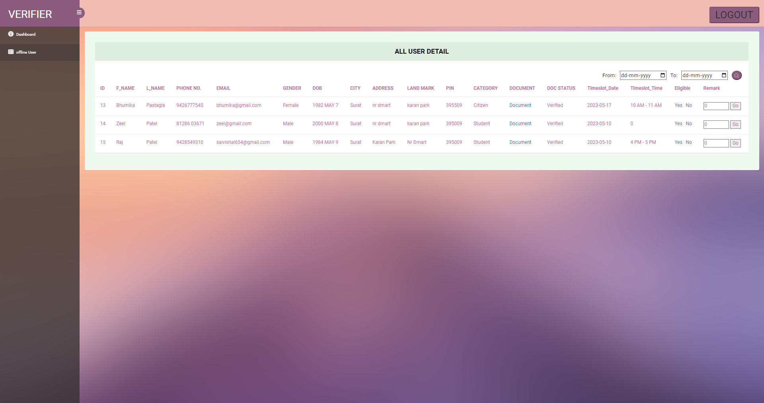
Verifier Dashboard
Today’s Offline Verification user Details

Slide 27
Advantages
User doesn’t need to stay in a long queue for getting bus pass, they can easily grab their bus pass by applying for it online.
Also, admin and verifier doesn’t need to handle the long queue
User doesn’t need to visit the office persistently for getting the required bus pass instead of user only need to visit once for verification of identity to receive the bus pass by using this application.
Admin and verifier get relief from burdensome of handling the lengthy process of paper work and documentation.
User obtain their e-bus pass after the completion of the verification process in this application.

Slide 28
disadvantages
This process is not fully online it needs the user interaction offline once for verification of their identity.
As increasing user, complexity for an admin increases so we need to appoint multiple admins per branch.
This application is only applicable to a single city.

Slide 29
Future scope
Planning of using cross platform for Users, Verifier Officer and Admin is under future scope. In future, Admin can verifier document in Android Application and Verifier can also use Android Application for verification in Identity. User can also apply for bus pass on Web Portal.
Existing Application serves only to a particular city but in future the planning for the service of this Application will be expanded to a Nation or an International level.
In feature user are increase we have to increase a number of verifier officer for document verification in place of admin.

Slide 30
conclusion
From BRTS BUSS PASS ONLINE REGISTRATION APPLICATION User can easily get their Bus Pass by applying in online mode by BRTS BUSS PASS ONLINE REGISTRATION APPLICATION without getting trouble of standing in long queue and filling long paper forms.
Admin and Verifier Officer can also easily help user getting their Bus Pass. Admin and Verifier Officer also need not to control the long queue and complexity in managing the paper works in offline mode.

Slide 31




THANK YOU

